Slide 1
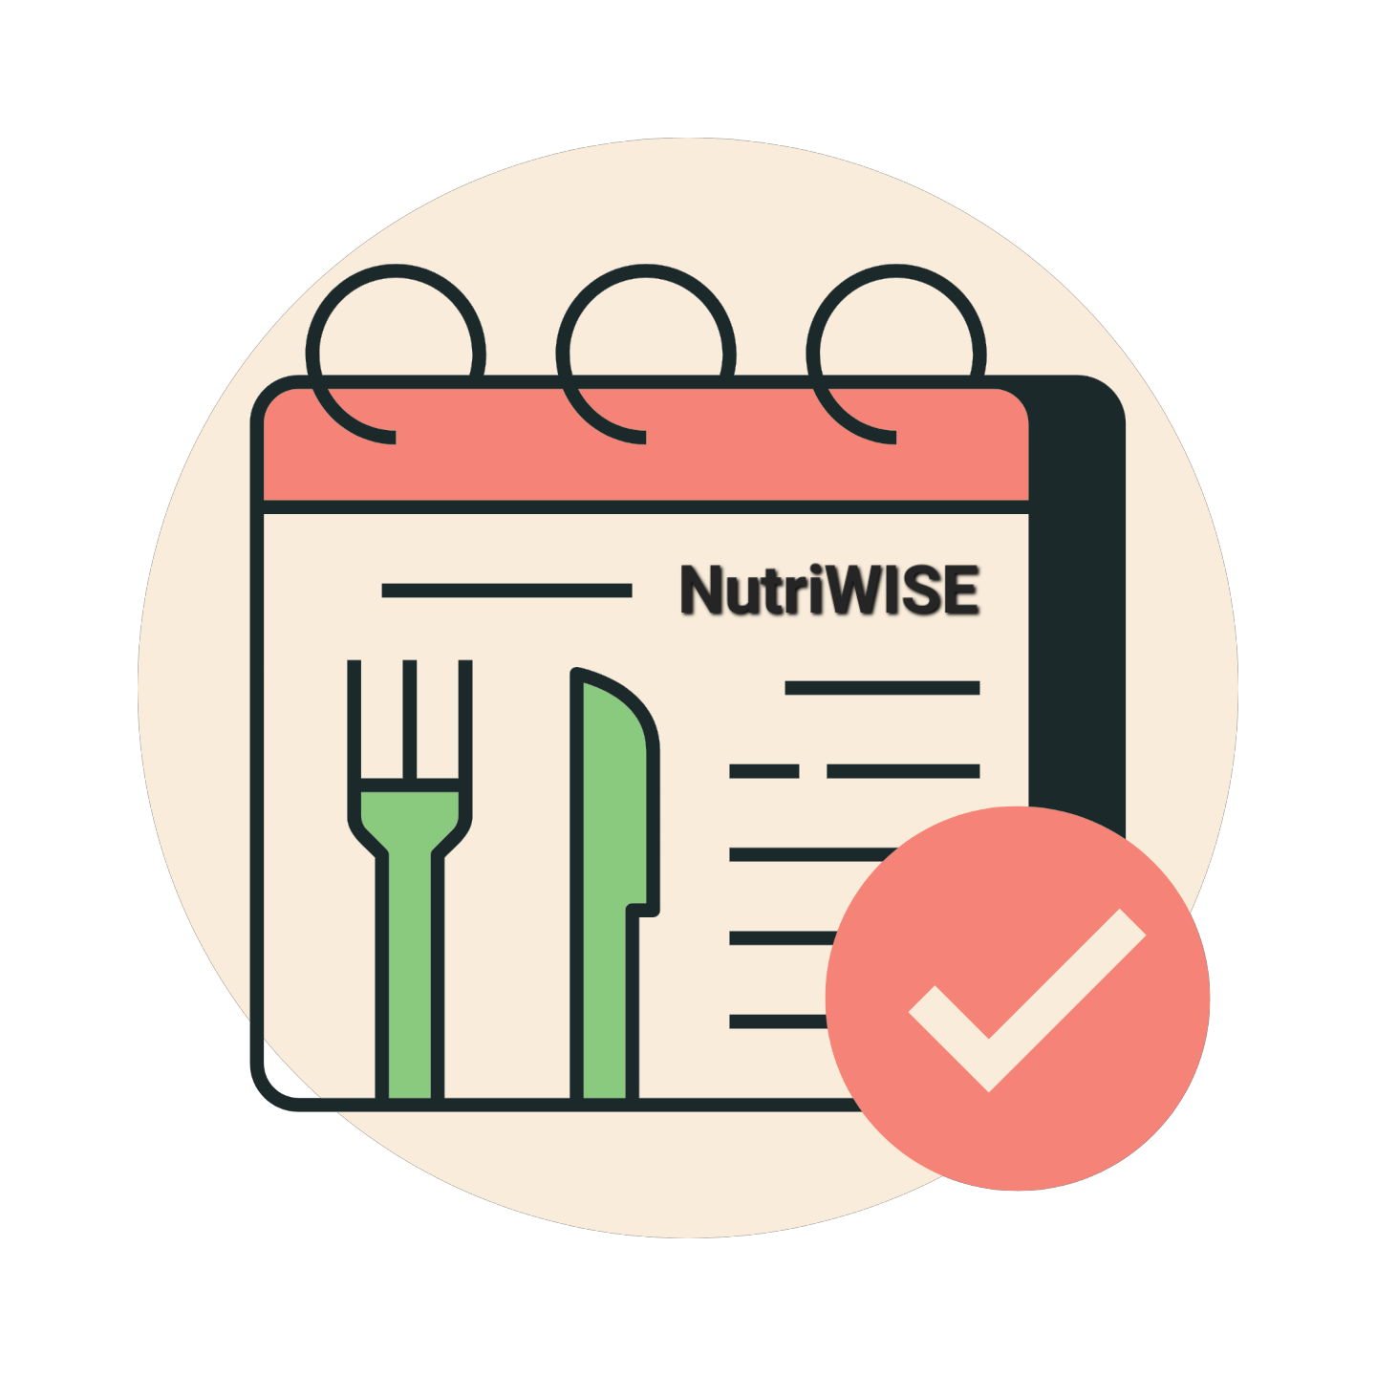
Notes:
NutriWISE is a cross platform app, can be used by BSND students as a mobile application where they can create meal plans, calculate the anthropometric measurements, and give proper food distribution, while professors can navigate it thru a web application, kung saan naman po ay makikita nila ung client info, food distribution, and ung courseware po na naglalaman ng classes and their own respective materials.

Slide 2


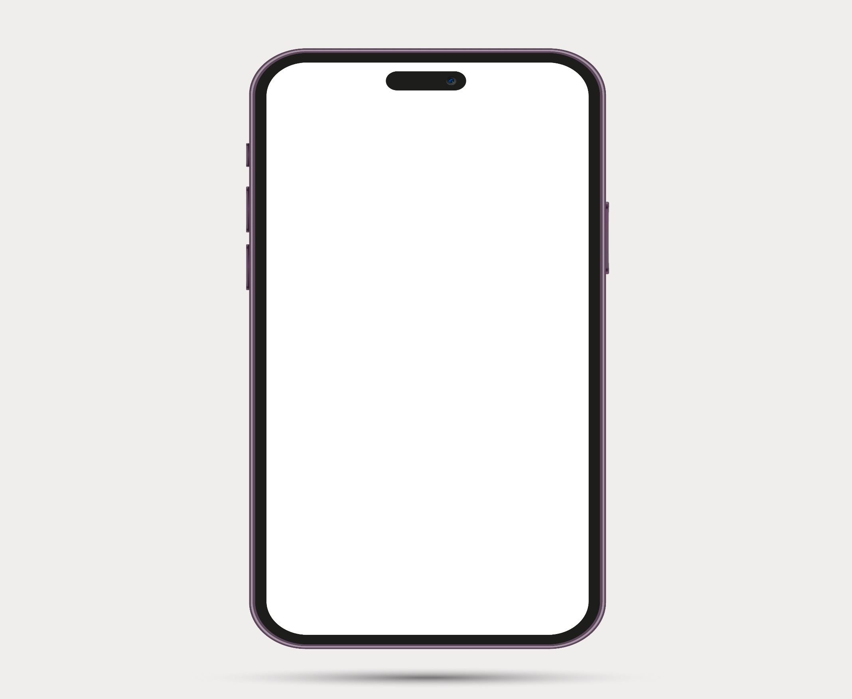

NutriWISE
Notes:
HOW DID WE COME UP IN PROPOSING NUTRIWISE? Here is a little background of our research.

Slide 3
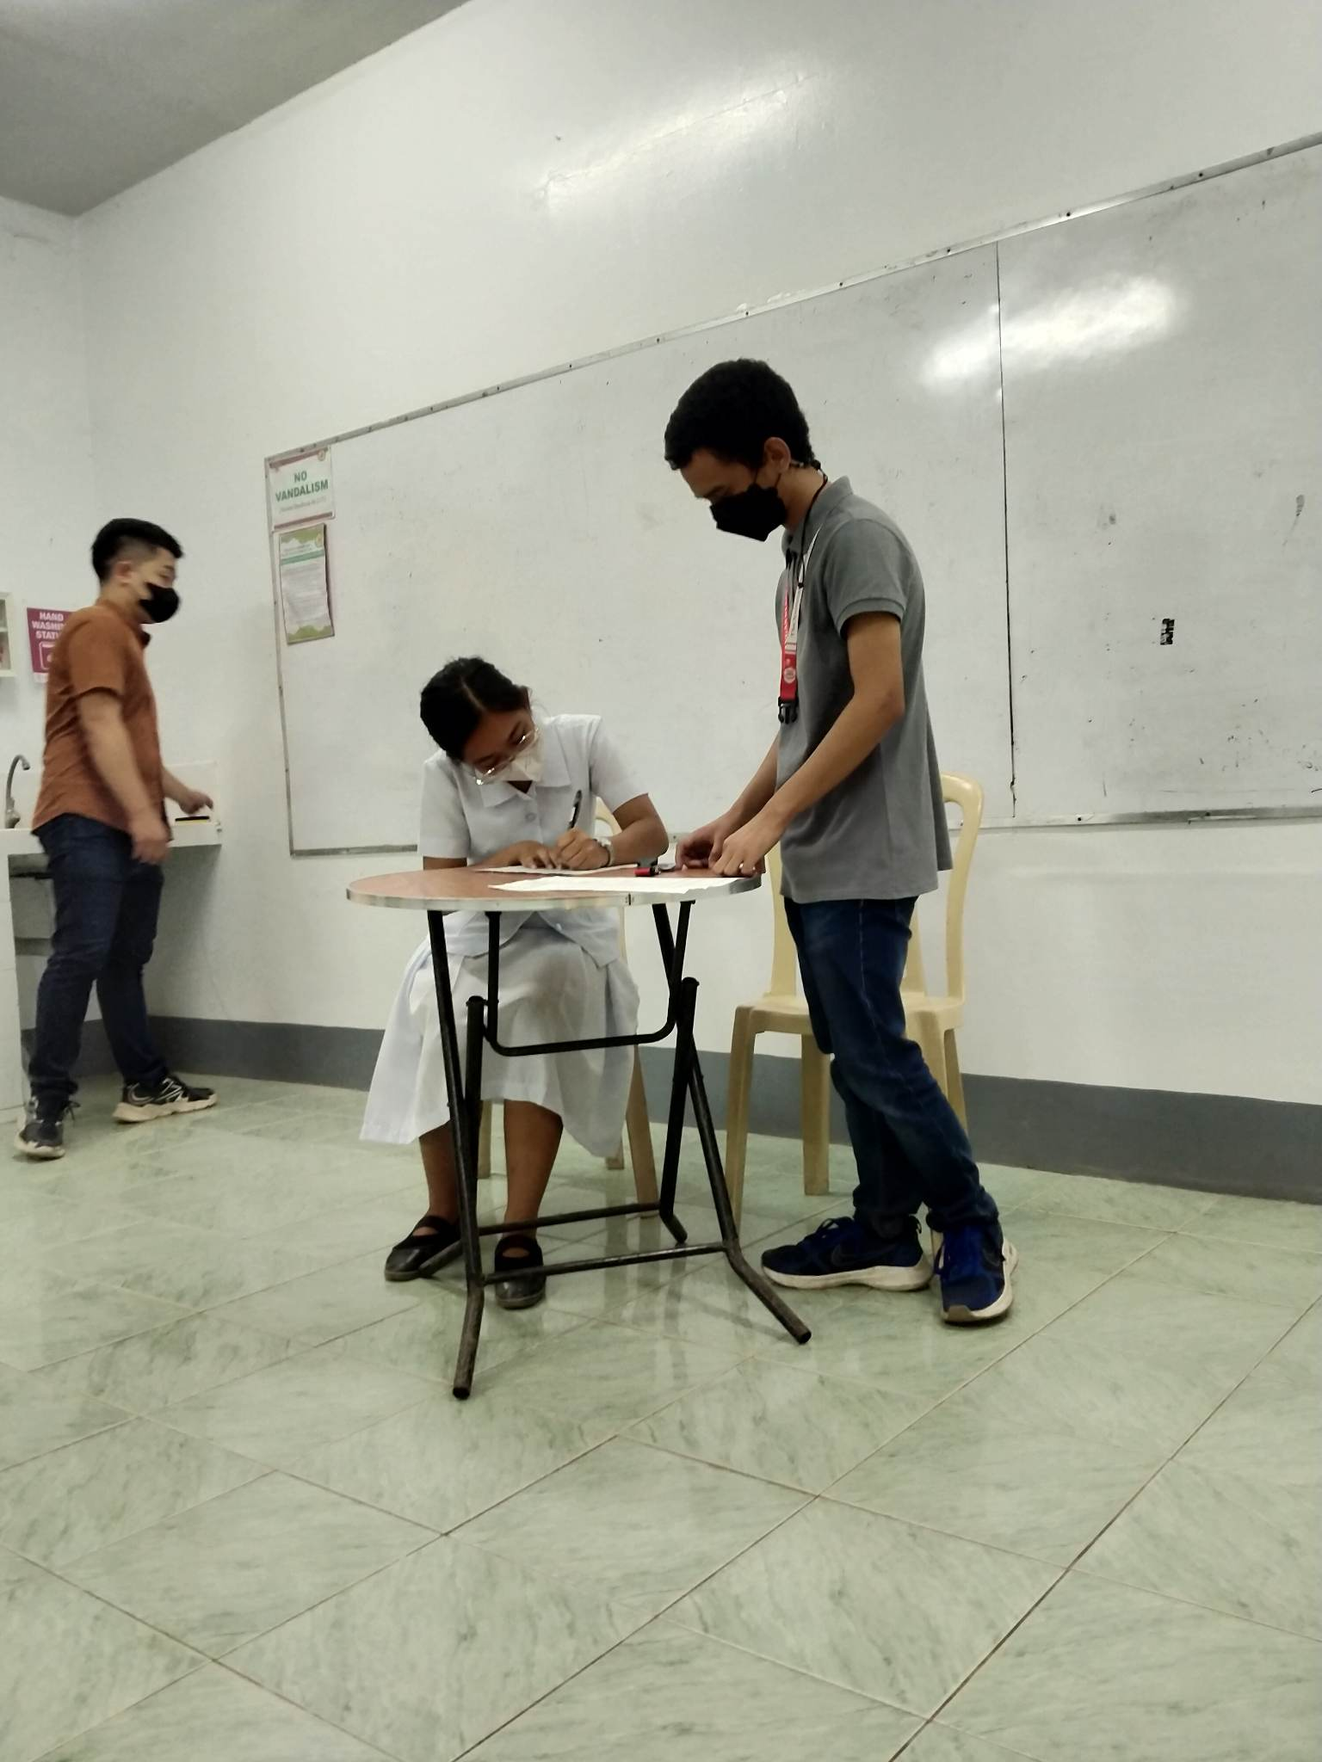
Notes:
CLIENT GOES TO THE CLINIC para magpagawa ng MEAL PLAN FOR THEM, BSND students gather info about name and age

Slide 4
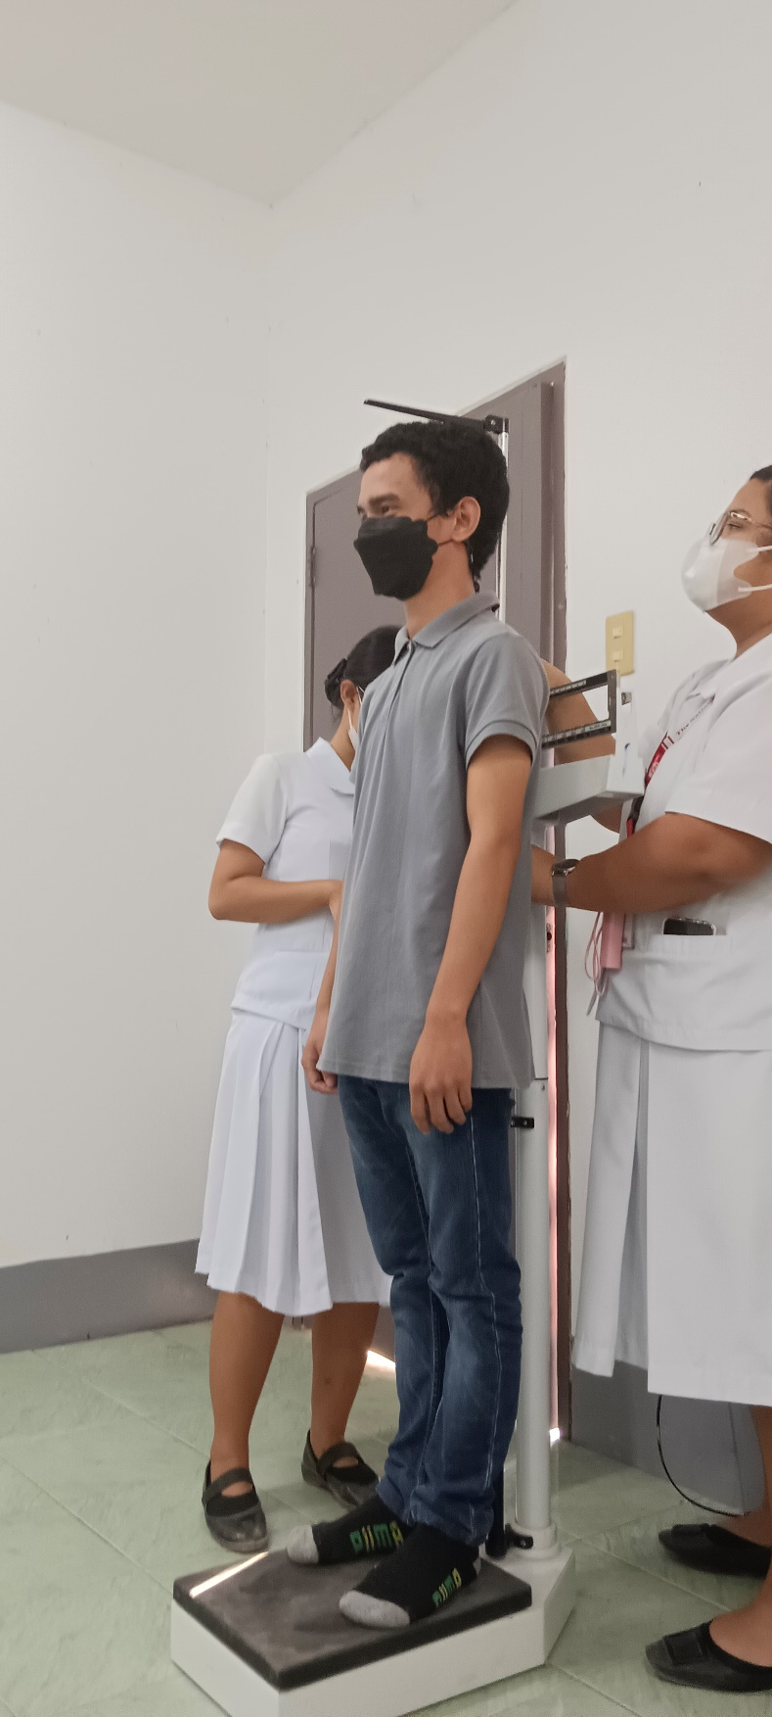
Notes:
BSND STUDENTS NEED TO GET THE CLIENTS ANTROPOMETRIC MEASUREMENTS, Physical activity level (Sedentary, Light, Moderate, Very Active)

Slide 5
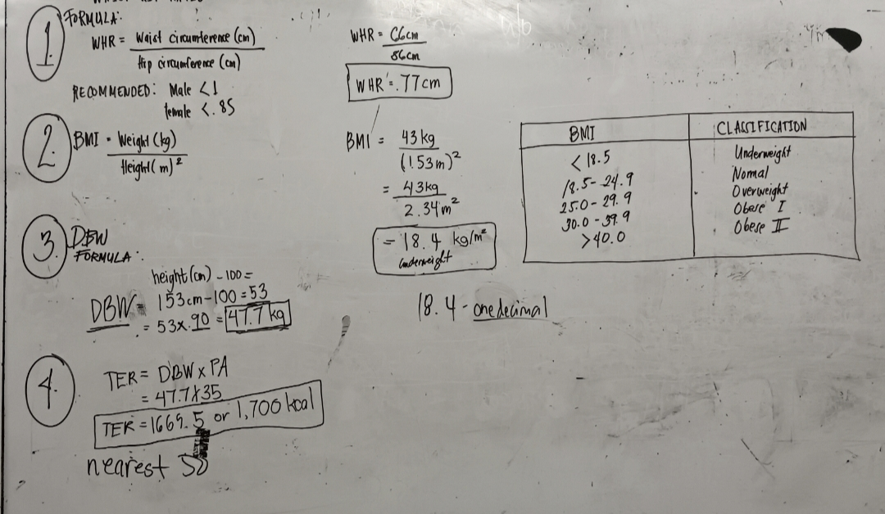
Notes:
THEY NEED TO CALCULATE THE ANTHOROPOMETRIC MEASUREMENTS TO GET THE BMI, WHR, DBW, and CALORIES PER FOOD GROUPS

Slide 6
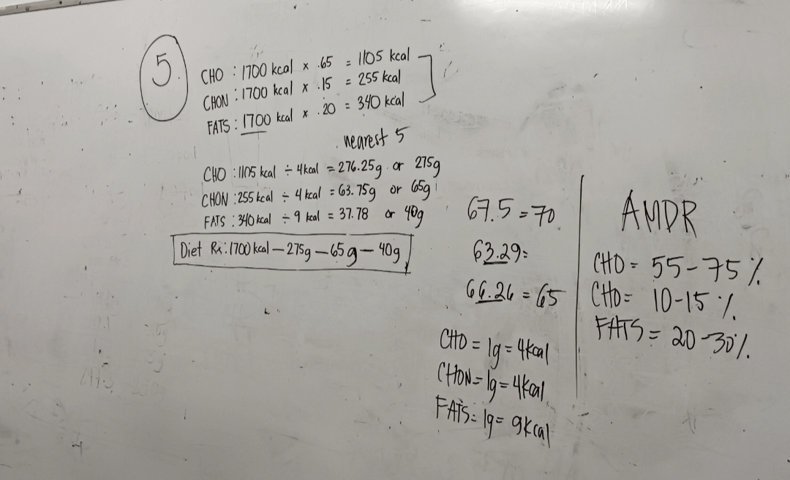
Notes:
THIS IS THE RESULT

Slide 7

Notes:
FOOD EXCHANGE LIST THEY NEED TO RELY ON THIS for the proper exchange distribution and for creating the meal plan for the client.

Slide 8
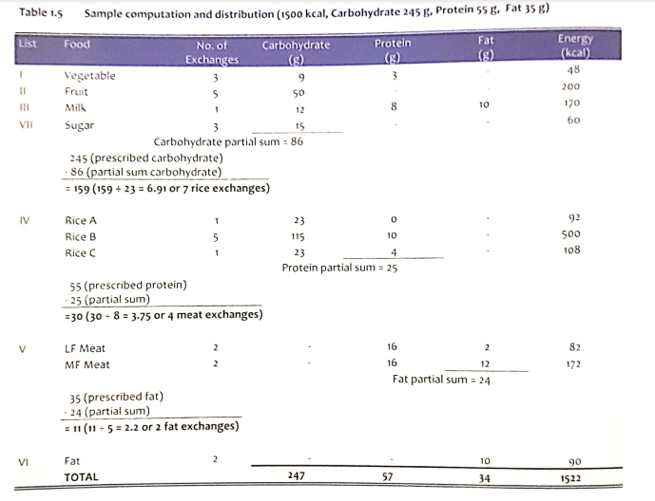
Notes:
CALCULATE THE RIGHT AMOUNT of distribution per food group, dito po papasok ung pagddistribute nila ng exchanges per food group under the carbohydrates, protein and fats. At para magawa nila to, kelangan po nila ng basis and standard values.

Slide 9
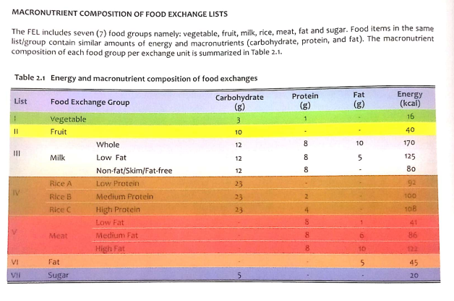
Notes:
BASIS/STANDARD VALUE, kelangan po nila to para mabigyan ng proper amount in grams po ang bawat exchange sa bawat food group.

Slide 10
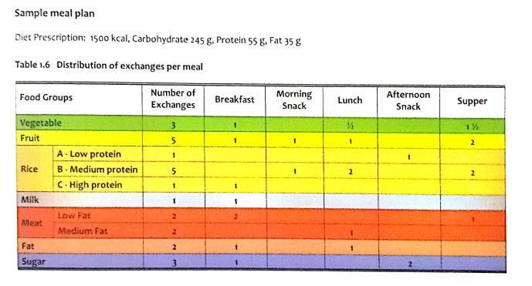
Notes:
SAMPLE MEAL PLAN WITH EXHANGE, hahati hatiin na po nila ung per food group into separate meal times of the day.

Slide 11
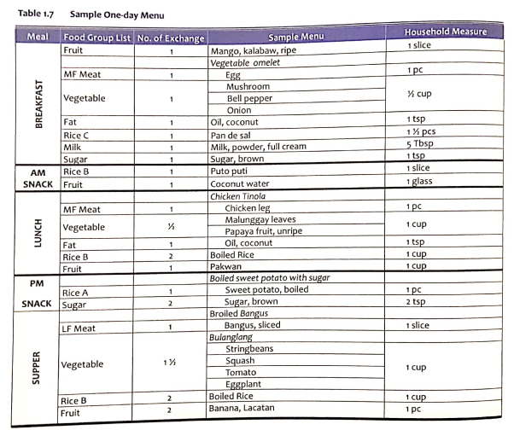
Notes:
SAMPLE ONE-DAY MENU na may respective food na po for each food group and meals of the day.

Slide 12
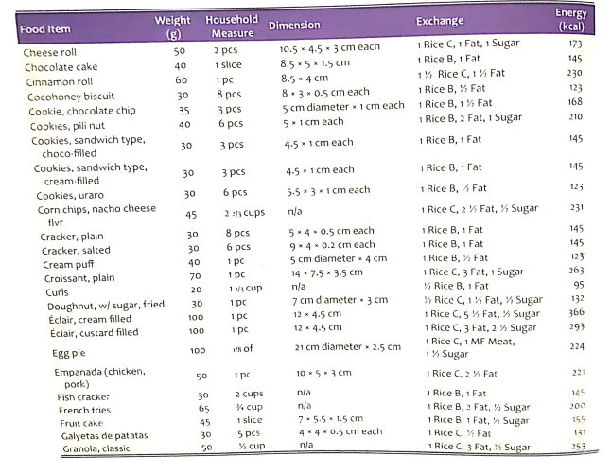
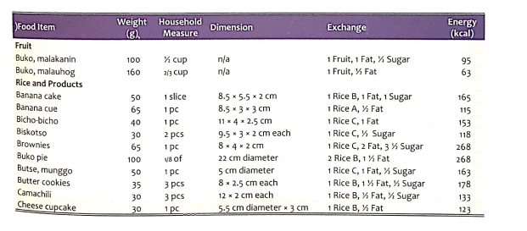
Notes:
LIST OF FOOD EXCHANGE LIST, where the student may choose the best suited food for the client.

Slide 13
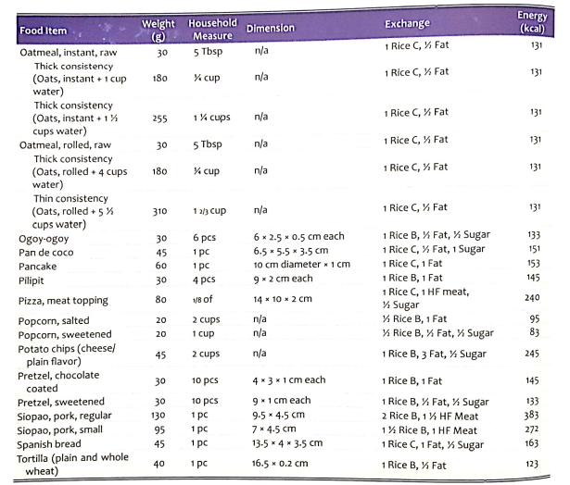
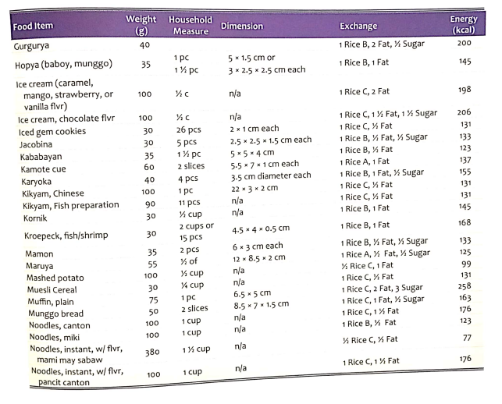

Slide 14
NutriWISE
Notes:
WE WILL INTEGRATE THAT PROCESS INSIDE THE NUTRIWISE APPLICATION, moreover po is I ddigitalize po naming ung process na ginagawa ng BSND students so it wont be too time consuming for both the students and the client.

Slide 15
THANK
YOU
☺

